Slide 1
Darien Student Survey Findings:
Mental Health & Substance Use Trends
Georgette Harrison, LPC, EdM
Director of Clinical and Community Partnerships
Child Guidance Center of Southern CT
Mitch Dickey, PhD
Licensed Psychologist
Former Yale Research Scientist

Slide 2
Agenda
Welcome
Introduction to the Thriving Youth Task Force
History of the Darien Youth Survey
Framework
Methodology
2021 Observations & Impact of COVID-19
Understanding Youth Substance Use
Understanding Youth Mental Health
Charting a Path Forward
Panel Discussion

Slide 3
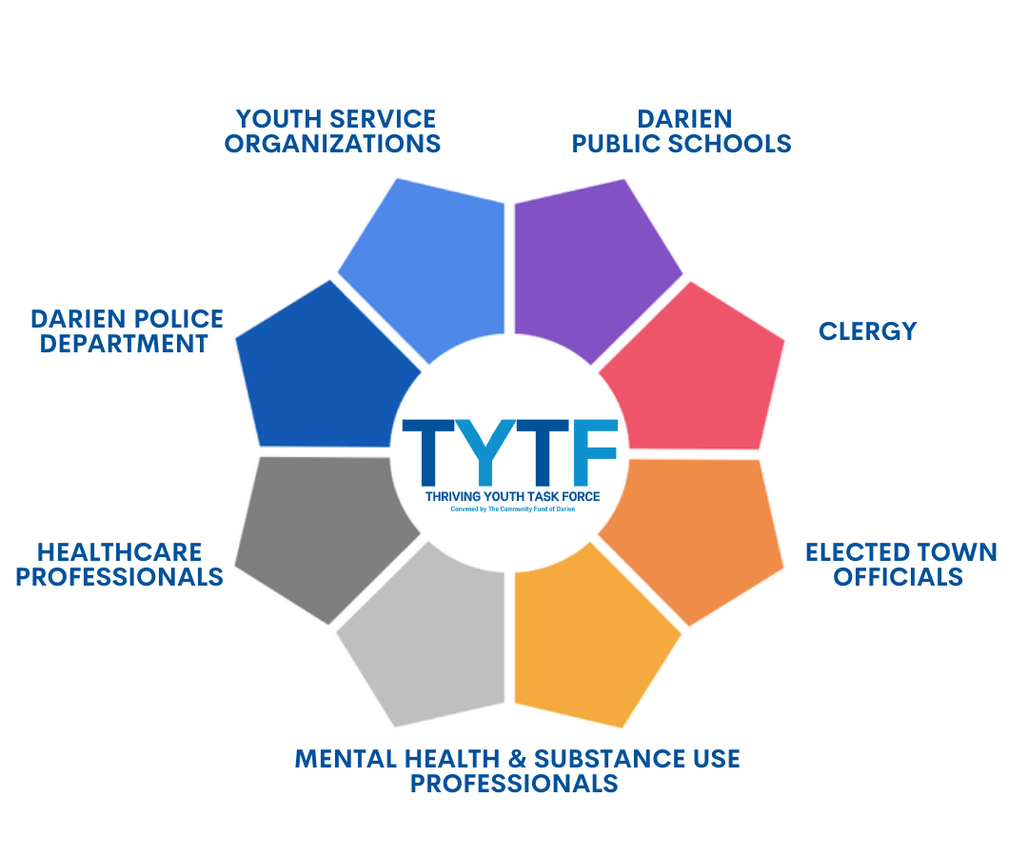
Introduction to Thriving Youth Task Force (TYTF)
The Thriving Youth Task Force (TYTF) is a volunteer coalition that convenes local community organizations to promote and empower positive youth development, with the goal of reducing teen substance use.
Founded in 2008
Task Force members include leaders from 35 organizations serving youth in Darien
7th year of grant funding focused on substance use reduction
Recently awarded a 5-year DFC grant
The Community Fund of Darien serves as the convener of TYTF and the fiduciary for any state or federal grants to support TYTF's prevention efforts

Slide 4
Thank you
SURVEY COMMITTEE:
Co-chairs: Shelly Skoglund and Shelley Sheridan
Amy Daniels
Allegra Erickson
Jennifer Fallon
Ingrid Gillespie
Georgette Harrison
Emily Larkin
Susannah Lewis
Sarah Neumann
Christina Passarretti
Alicia Sillars
Darien Public Schools
MMS & DHS students and parents

Slide 5
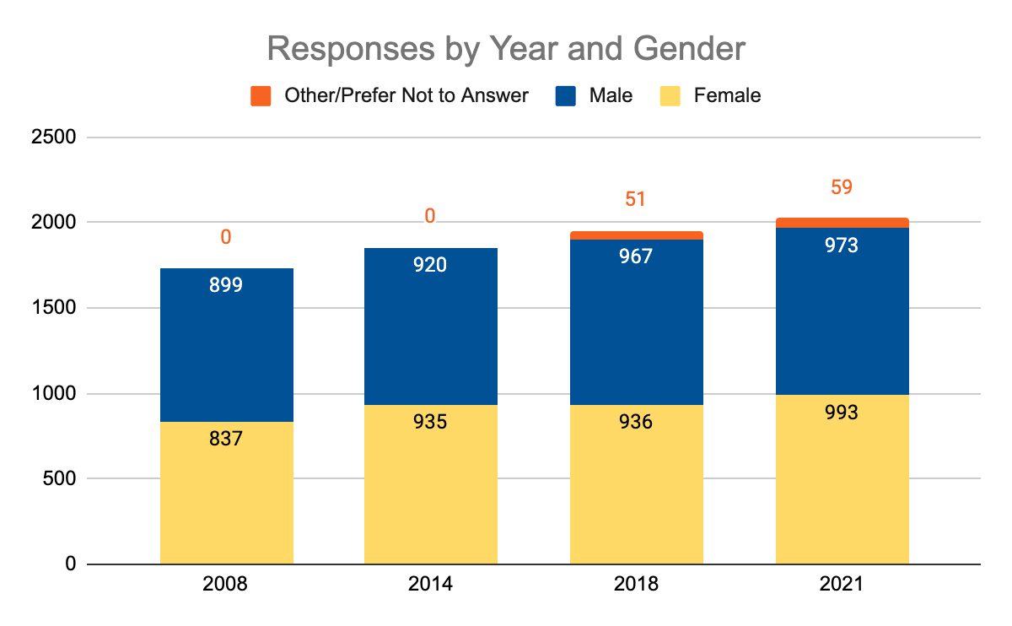
History of the Survey
First completed in 2008, every three years since
5th iteration
Partnership with Darien Public Schools, 7th -12th grades
Anonymous; parent opt-out option
Similar student/parent surveys are implemented nationally and regionally including: Westport, Greenwich, Fairfield, Stamford and Norwalk

Slide 6
What’s Different This Year?
2018
Two surveys
Focus on substance use
Descriptive Analyses - % of students who answer
2021
One combined survey
Expanded survey domains: Stress/pressure, mental health, etc.
Predictive analyses/machine learning
cluster analyses to form groups
decision tree analyses to identify what factors drive behavior

Slide 7
2021 Survey Overview & Observations
COVID-19’s Impact on Survey Results:
Survey is a snapshot of unprecedented times
Impact of stay-at-home orders, social distancing, close proximity to family members on access to substances
Hidden Pandemic: rising rates of mental health concerns
Two primary areas of interest: Substance Use and Mental Health
Less focus on percentages
More insight into WHY
Actionable and insightful conclusions

Slide 8
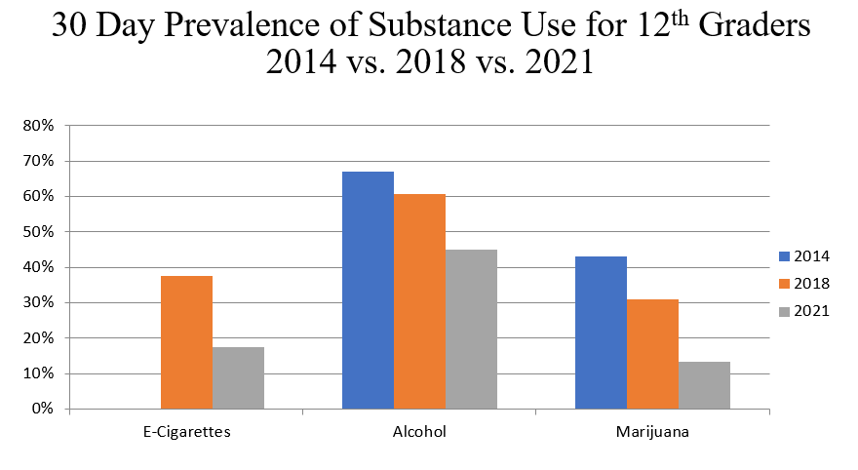
Impact of COVID-19
Students reported changes in how they were spending their time and how they were feeling in response to COVID-19
Substance use decreased across all categories
More time consuming online content and interacting with social media
Less time playing sports or interacting with friends in person
Majority of students reported feeling more anxiety, sadness and loneliness/isolation
Darien is not alone in this trend
12th Grade Substance Use Trends
2014, 2018, 2021

Slide 9
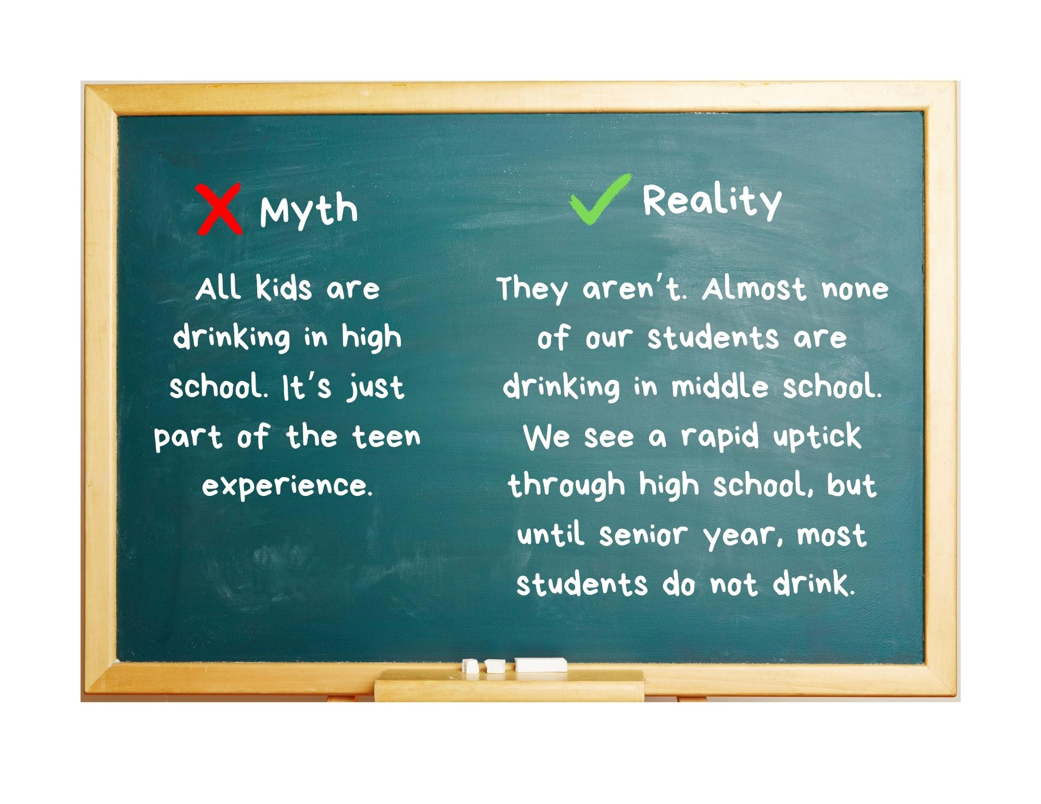
Student Substance Use

Slide 10
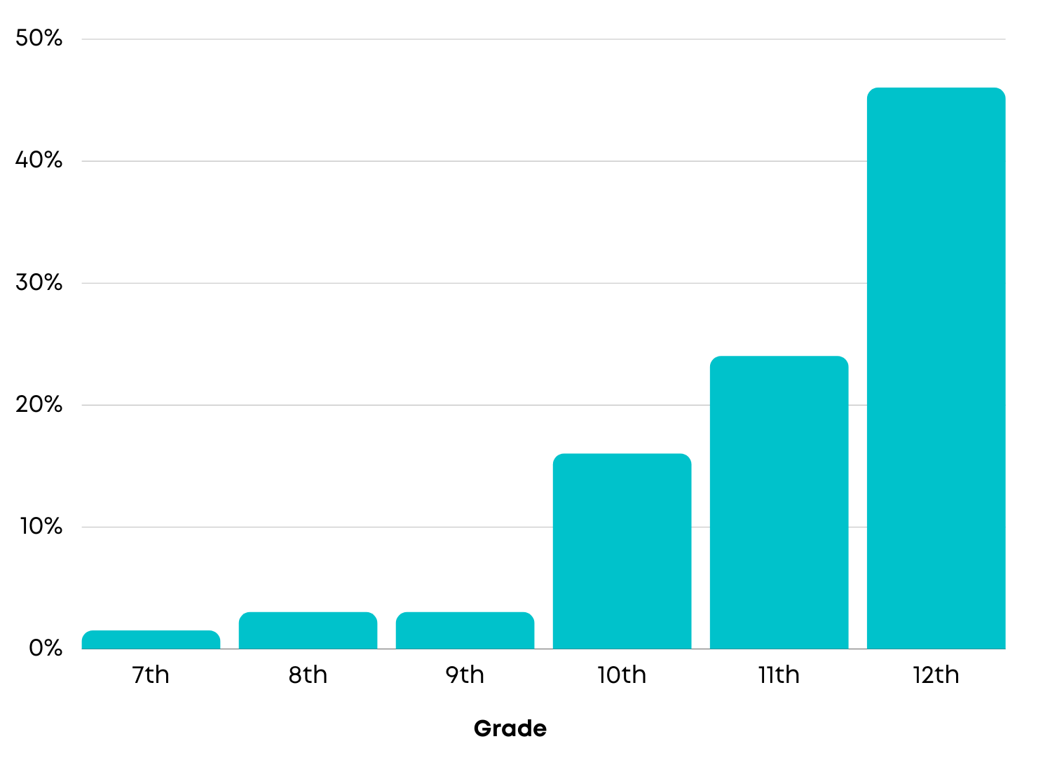
Student Alcohol Use
2021 Past 30 Day Alcohol Use
by Grade
46%
24%
16%
1%
2.5%
3%

Slide 11
Student Substance Use Categories
The analysis looked for patterns of use and behaviors. Findings grouped 7-12th grade students into four categories based on their responses to several questions about their use.
No use- Students who are substance-free
Alcohol only- Students who are drinking, but not too frequently or heavily and are not using any other substances
Moderate use- Students who are drinking frequently AND using other substances, mostly marijuana
Heavy use- Students who are drinking heavily, frequently and using other substances, mostly marijuana

Slide 12
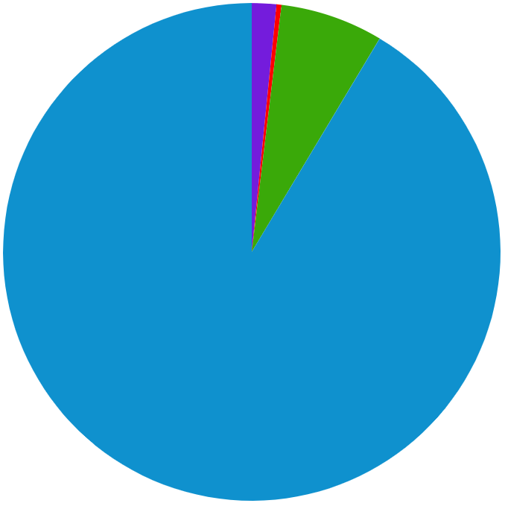
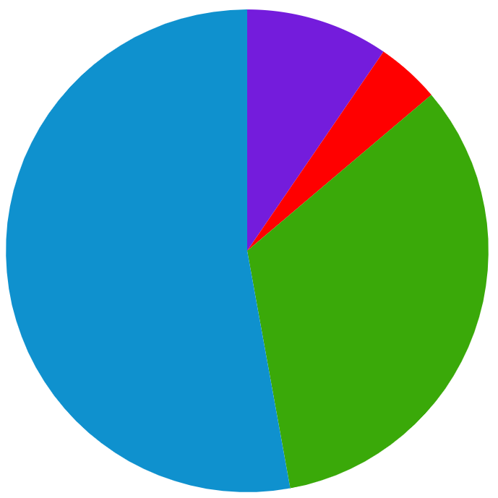
Student Substance Use: What did we learn?
Substance use patterns change dramatically as teens get older
0.6%
1.6%
10%
7%
4%
53%
99%
91%
33%
7th - 8th Graders
9th - 10th Graders
11th - 12th Graders

Slide 13
Student Substance Use: Observations
Our analysis highlighted interesting trends in substance use among our teens:
For those who do use substances, the most commonly used substance for Darien teens is alcohol
Grade is the single biggest predictor of use
Sadness, anxiety and loneliness did not predict substance use
Unless you add exposure to bullying and remove grade from the model

Slide 14
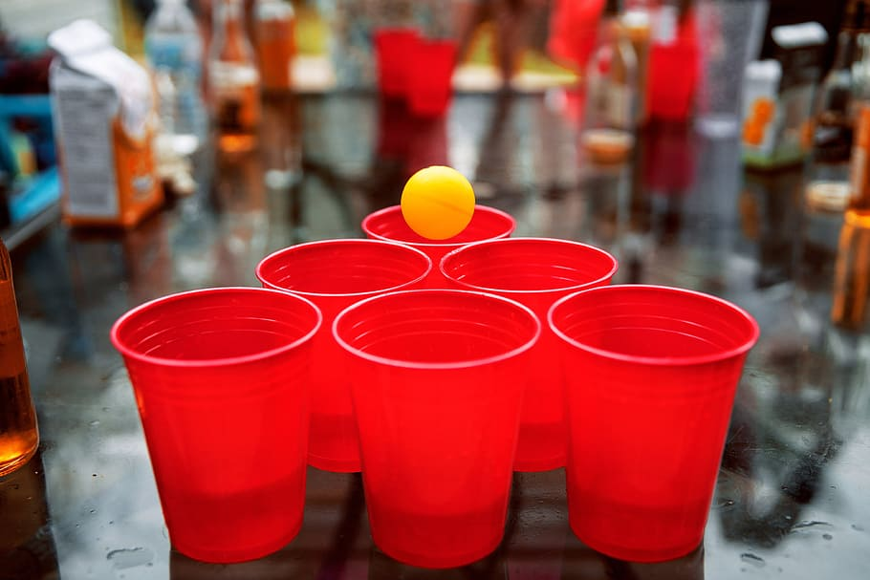
Who are we most concerned about:
Students Who Report Moderate/Heavy Use
Picture of a teen party culture: students in this category are drinking frequently and in large quantities and experiencing a lot of consequences along the way.
Who: 30% of 11th & 45% of 12th graders
Where: Drinking at parties without adults present
What are they doing:
The # 1 reason 11th & 12th graders drink is to have fun
Playing competitive drinking games
Blacking out
Experiencing hangovers
Taking care of friends who have too much to drink
Buying alcohol at stores outside Darien
Using multiple substances, not just alcohol

Slide 15
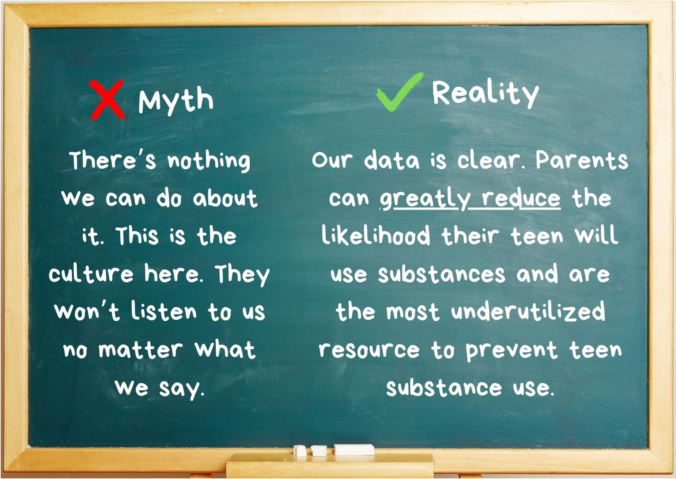
Substance Use Findings

Slide 16
Factors Associated with Substance-Free Students
INDIVIDUAL VARIABLES:
Top reasons for not drinking: “I just don’t want to” or “parents are strict”
Eager to do well in school
Feel equipped to deal well with frustration
Peer disapproval of marijuana and alcohol use
Presence of positive adult role models
Report feeling safe & secure at home
Willing to talk to their parents about alcohol, drugs or sex

Slide 17
Factors Associated with Substance-Free Students
Parents have an important role to play in substance use prevention.
PARENT/FAMILY VARIABLES:
Parents try to know where they are at night/weekends
For younger students, parents know where they are during the day
Parents are on the same page about substance use
Parents set very clear rules about alcohol use
Parents STRONGLY disapprove of substance use
However, student perception of parental disapproval of drinking declines rapidly in high school
Parental vigilance is the most important factor in reducing substance use in Darien teens

Slide 18
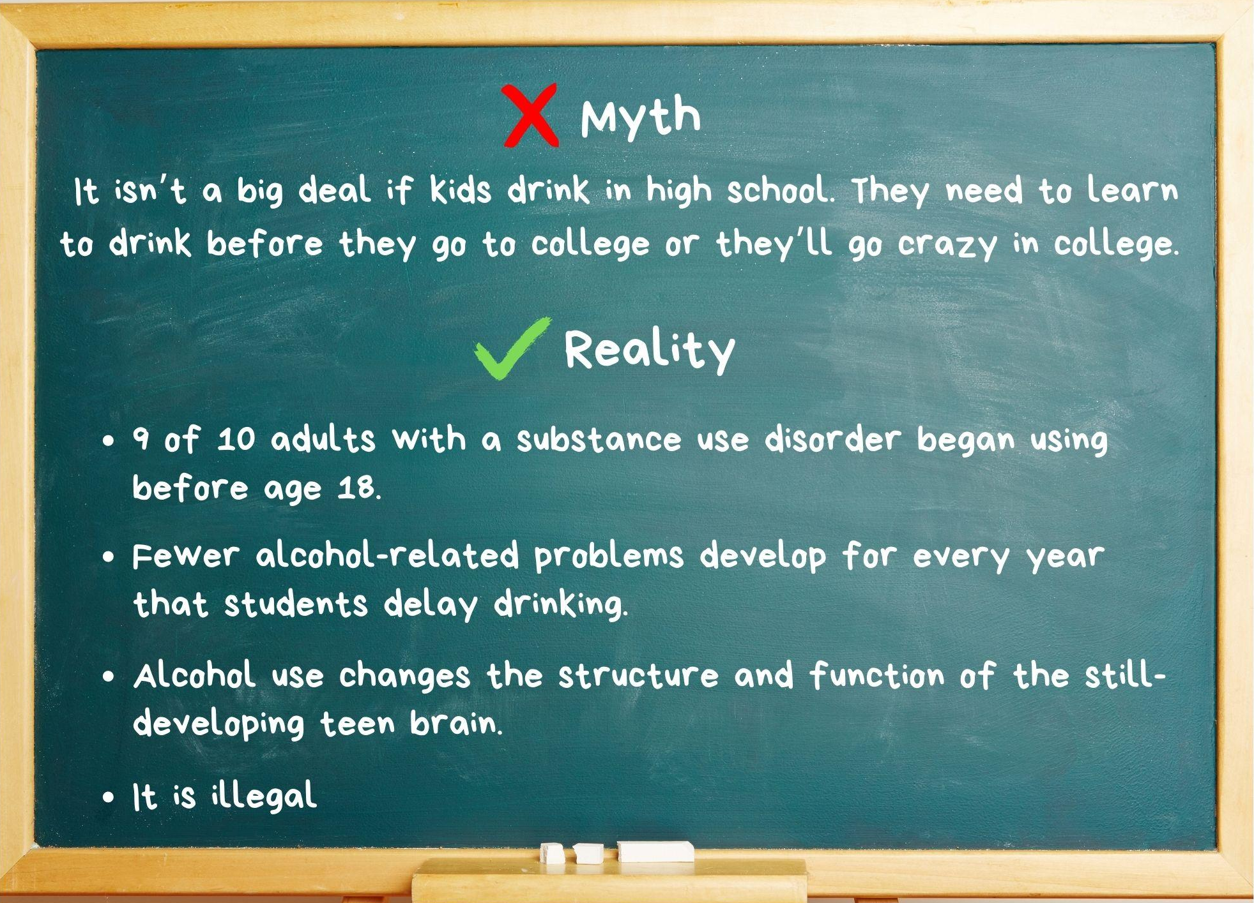
Substance Use Findings

Slide 19
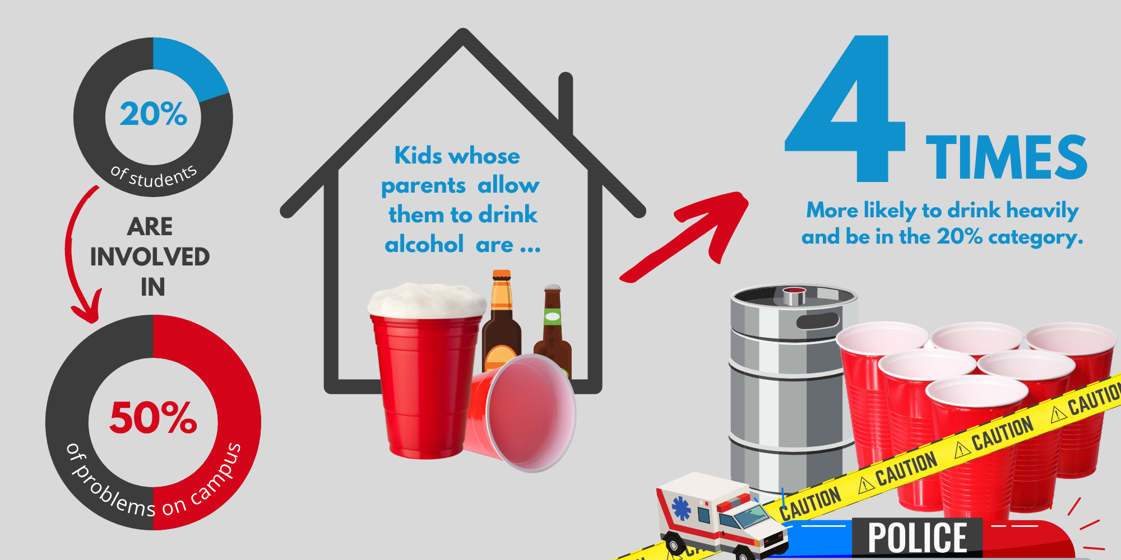
Turrisi Study
“Allowing your kids to drink is not protective.” - Dr. Turrisi
Source: Turrisi, R., Mallett, K., Varvil-Weld, L., & Guttman, K. (2013). Examining the role of parents in college student alcohol etiology and prevention.

Slide 20
Key Takeaways About Teen Substance Use for Parents
Parents have an important role to play in substance use prevention.
Factors that reduce use:
Vigilance: knowing where they are and what they’re doing
Setting and reinforcing explicit, clear rules and expectations about substance use
Conveying strong levels of disapproval of substance use
Keeping open lines of communication with children
It’s possible (and vital) to have an open, trusting relationship with our teens and provide clear messages about how to stay safe

Slide 21
Student Mental Health

Slide 22
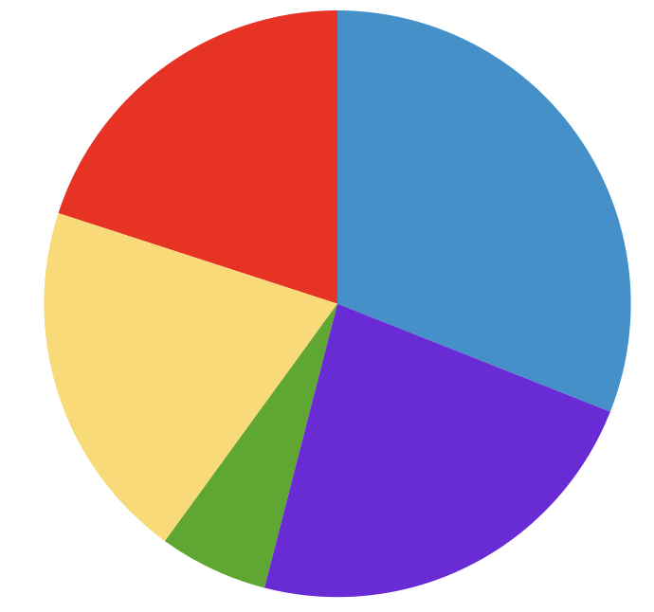
Student Mental Health Clusters
Five categories based on student responses to several questions about how they’re feeling
Thriving: students feel good about themselves, experience low levels of sadness, anxiety & loneliness
OK: students feel ok about themselves, but sometimes experience some sadness, anxiety and loneliness
Anxious: students feel ok about themselves, but experience high levels of anxiety, low levels of loneliness and sadness
Vulnerable:students aren’t feeling good about themselves experience high levels of sadness, anxiety and loneliness
Distressed: students are feeling BAD about themselves, experience highest levels of sadness, anxiety and loneliness
20%
31%
20%
23%
6%

Slide 23
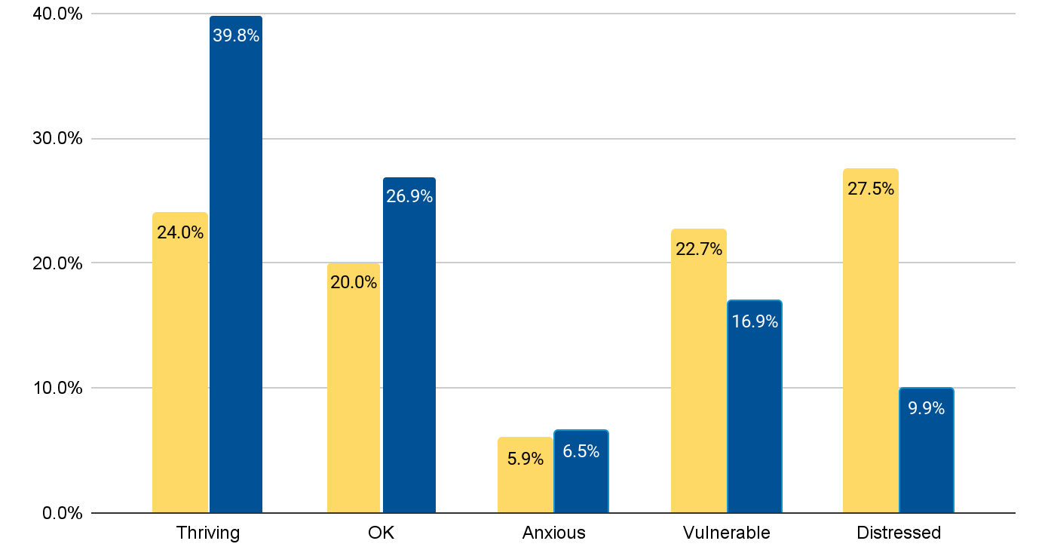
Gender Dif ferences

Slide 24
Mental Health: Female Students
Much higher levels of sadness, anxiety and loneliness across all grades, particularly in 10-12th grades
Report more social stress
Social media
Protective Factors:
Feeling valued by others and in control of their life
Family environment - perception of parental approval, comfort in talking to parents about serious issues, inclusion in family decision making

Slide 25
Mental Health: Male Students
Report lower levels of sadness, anxiety and loneliness across all grades
Report more academic stress
Protective Factors:
Social environment- mentors, coaches, teachers, neighbors
Family environment- open lines of communication

Slide 26
Protective Factors Associated with Good Mental Health
INDIVIDUAL VARIABLES:
Feeling valued
Feeling in control of their life and future
Developing a sense of purpose in life
Developing good health habits
Avoiding things they believe are dangerous or unhealthy
COMMUNITY VARIABLES:
Engaged in learning
Engaged in clubs/groups in or out of school

Slide 27
Protective Factors Associated with Good Mental Health
FAMILY VARIABLES:
Spending quality time with family
Time with parents/messages from parents make them feel good about themselves
Perceive parental advice as helpful
Receiving strong parent messages about prosocial behavior
Meeting parents’ expectations is not a source of stress

Slide 28
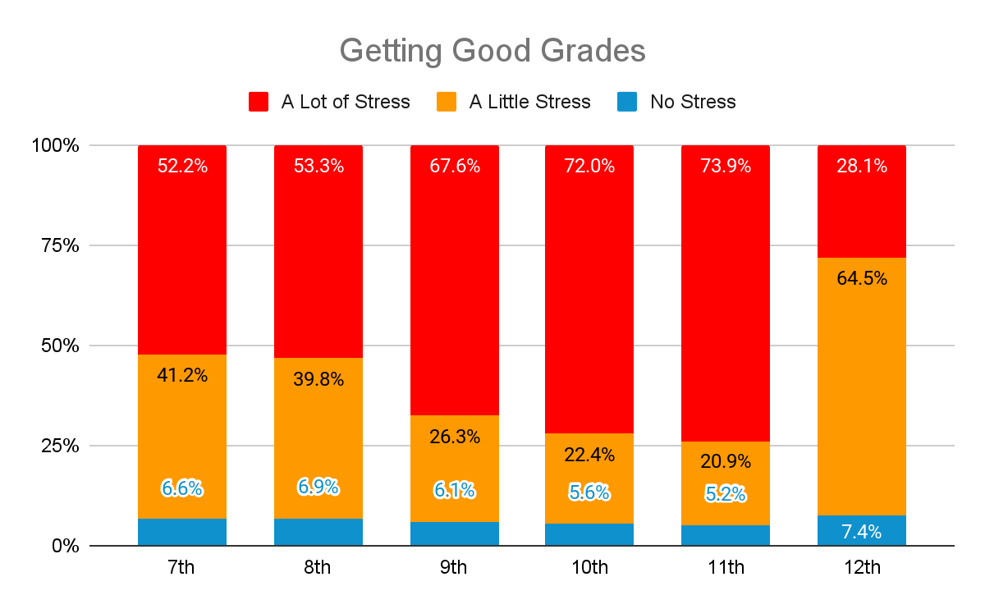
Sources of Stress: Getting Good Grades

Slide 29
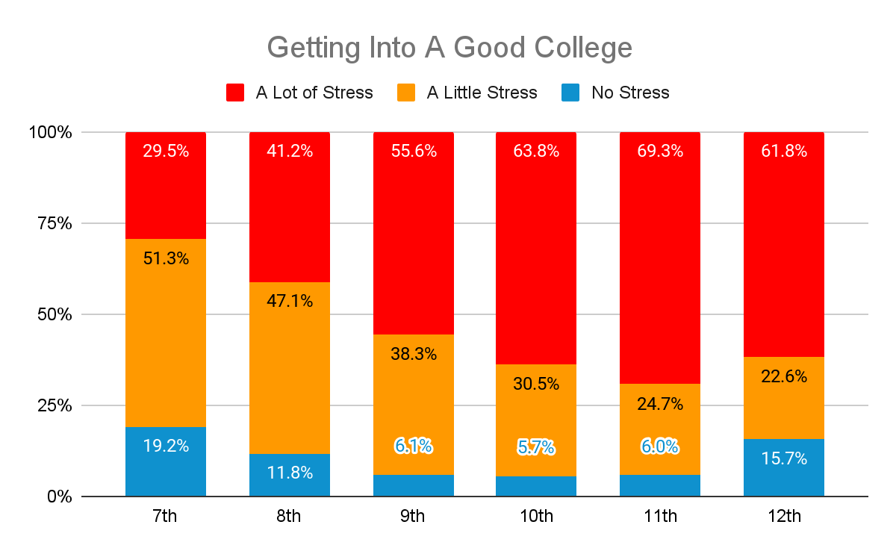
Sources of Stress: Getting Into a Good College

Slide 30
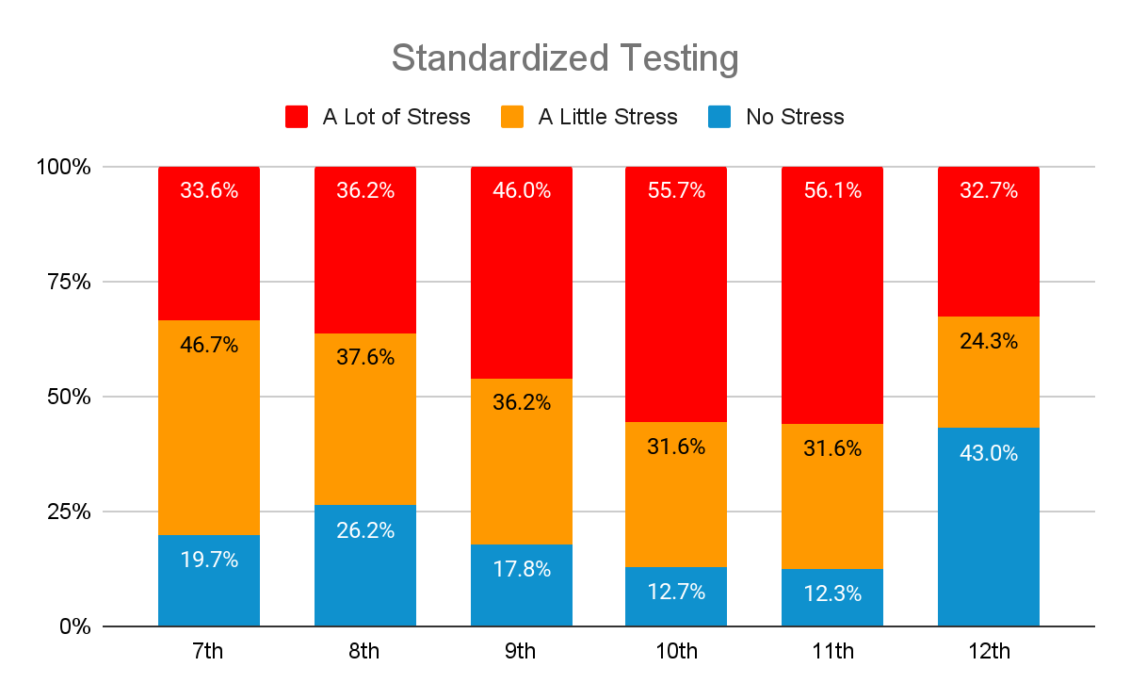
Sources of Stress: Standardized Testing

Slide 31
Other Significant Sources of Stress
Meeting my Parents’ Expectations
Across all grades
Excelling in Sports
Particularly true for 9th graders
COVID/Pandemic-Related Losses
Particularly true for 12th graders

Slide 32
Minimal Sources of Stress

Slide 33
Key Takeaways About Teen Mental Health
Protective Factors:
It is essential for teens to feel valued
It is very important for teens to feel they are in control of their lives and developing a sense of purpose
Academic pressure is a significant source of stress
Having an open line of communication with teens is associated with good mental health

Slide 34
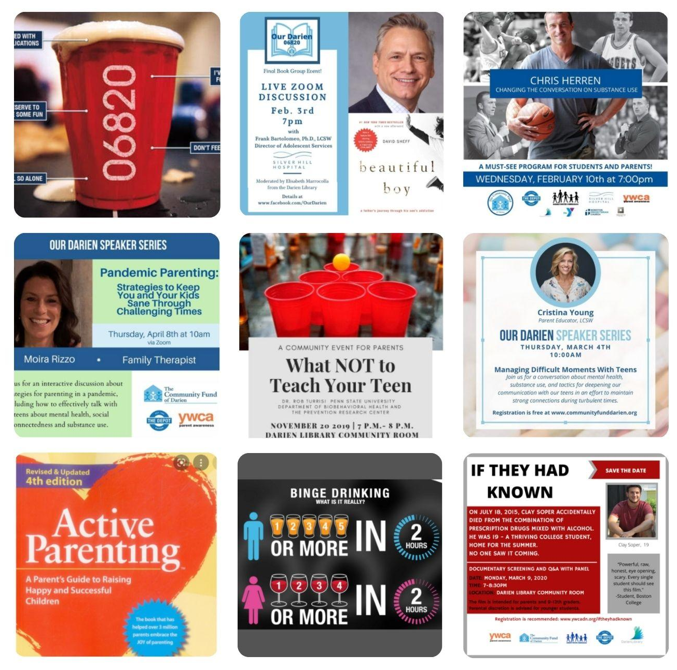
TYTF Responses to Past Survey Data

Slide 35
Charting a Path Forward
Supporting parents with:
Keeping lines of communication open within the family and spending time together
Having clear messages about disapproval of substance use at this age
Developmentally appropriate parental vigilance
Identifying when stress becomes paralyzing
Engaging as a community by:
Helping students feel valued for who they are and feel in control of their lives
Providing intensive support for students who report they are struggling
Building your student’s team
This is just a start.
We want to hear from you!

Slide 36
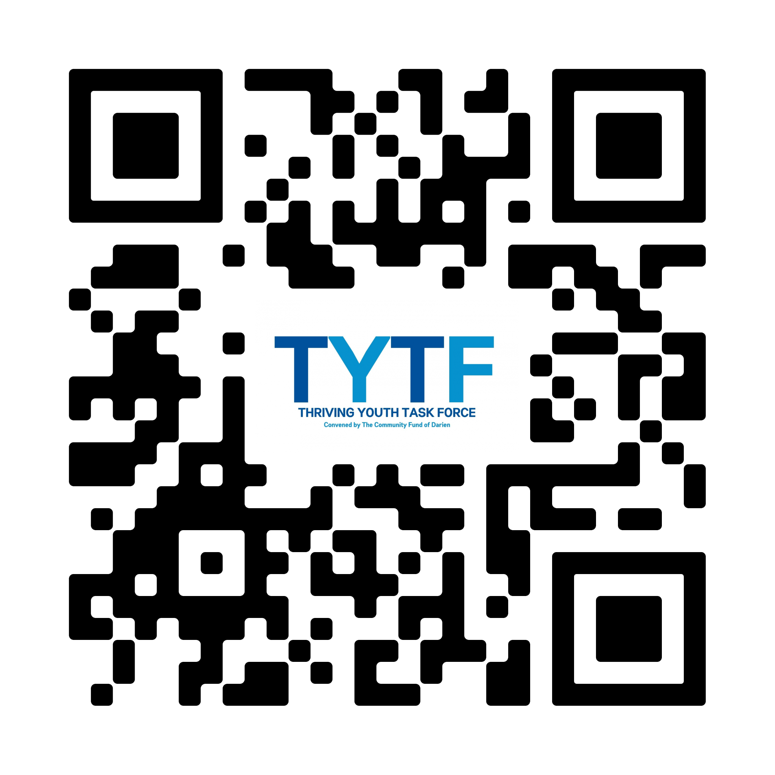
Save the Date!
Register at:
communityfunddarien.org/tytf-programs-and-events.

Slide 37
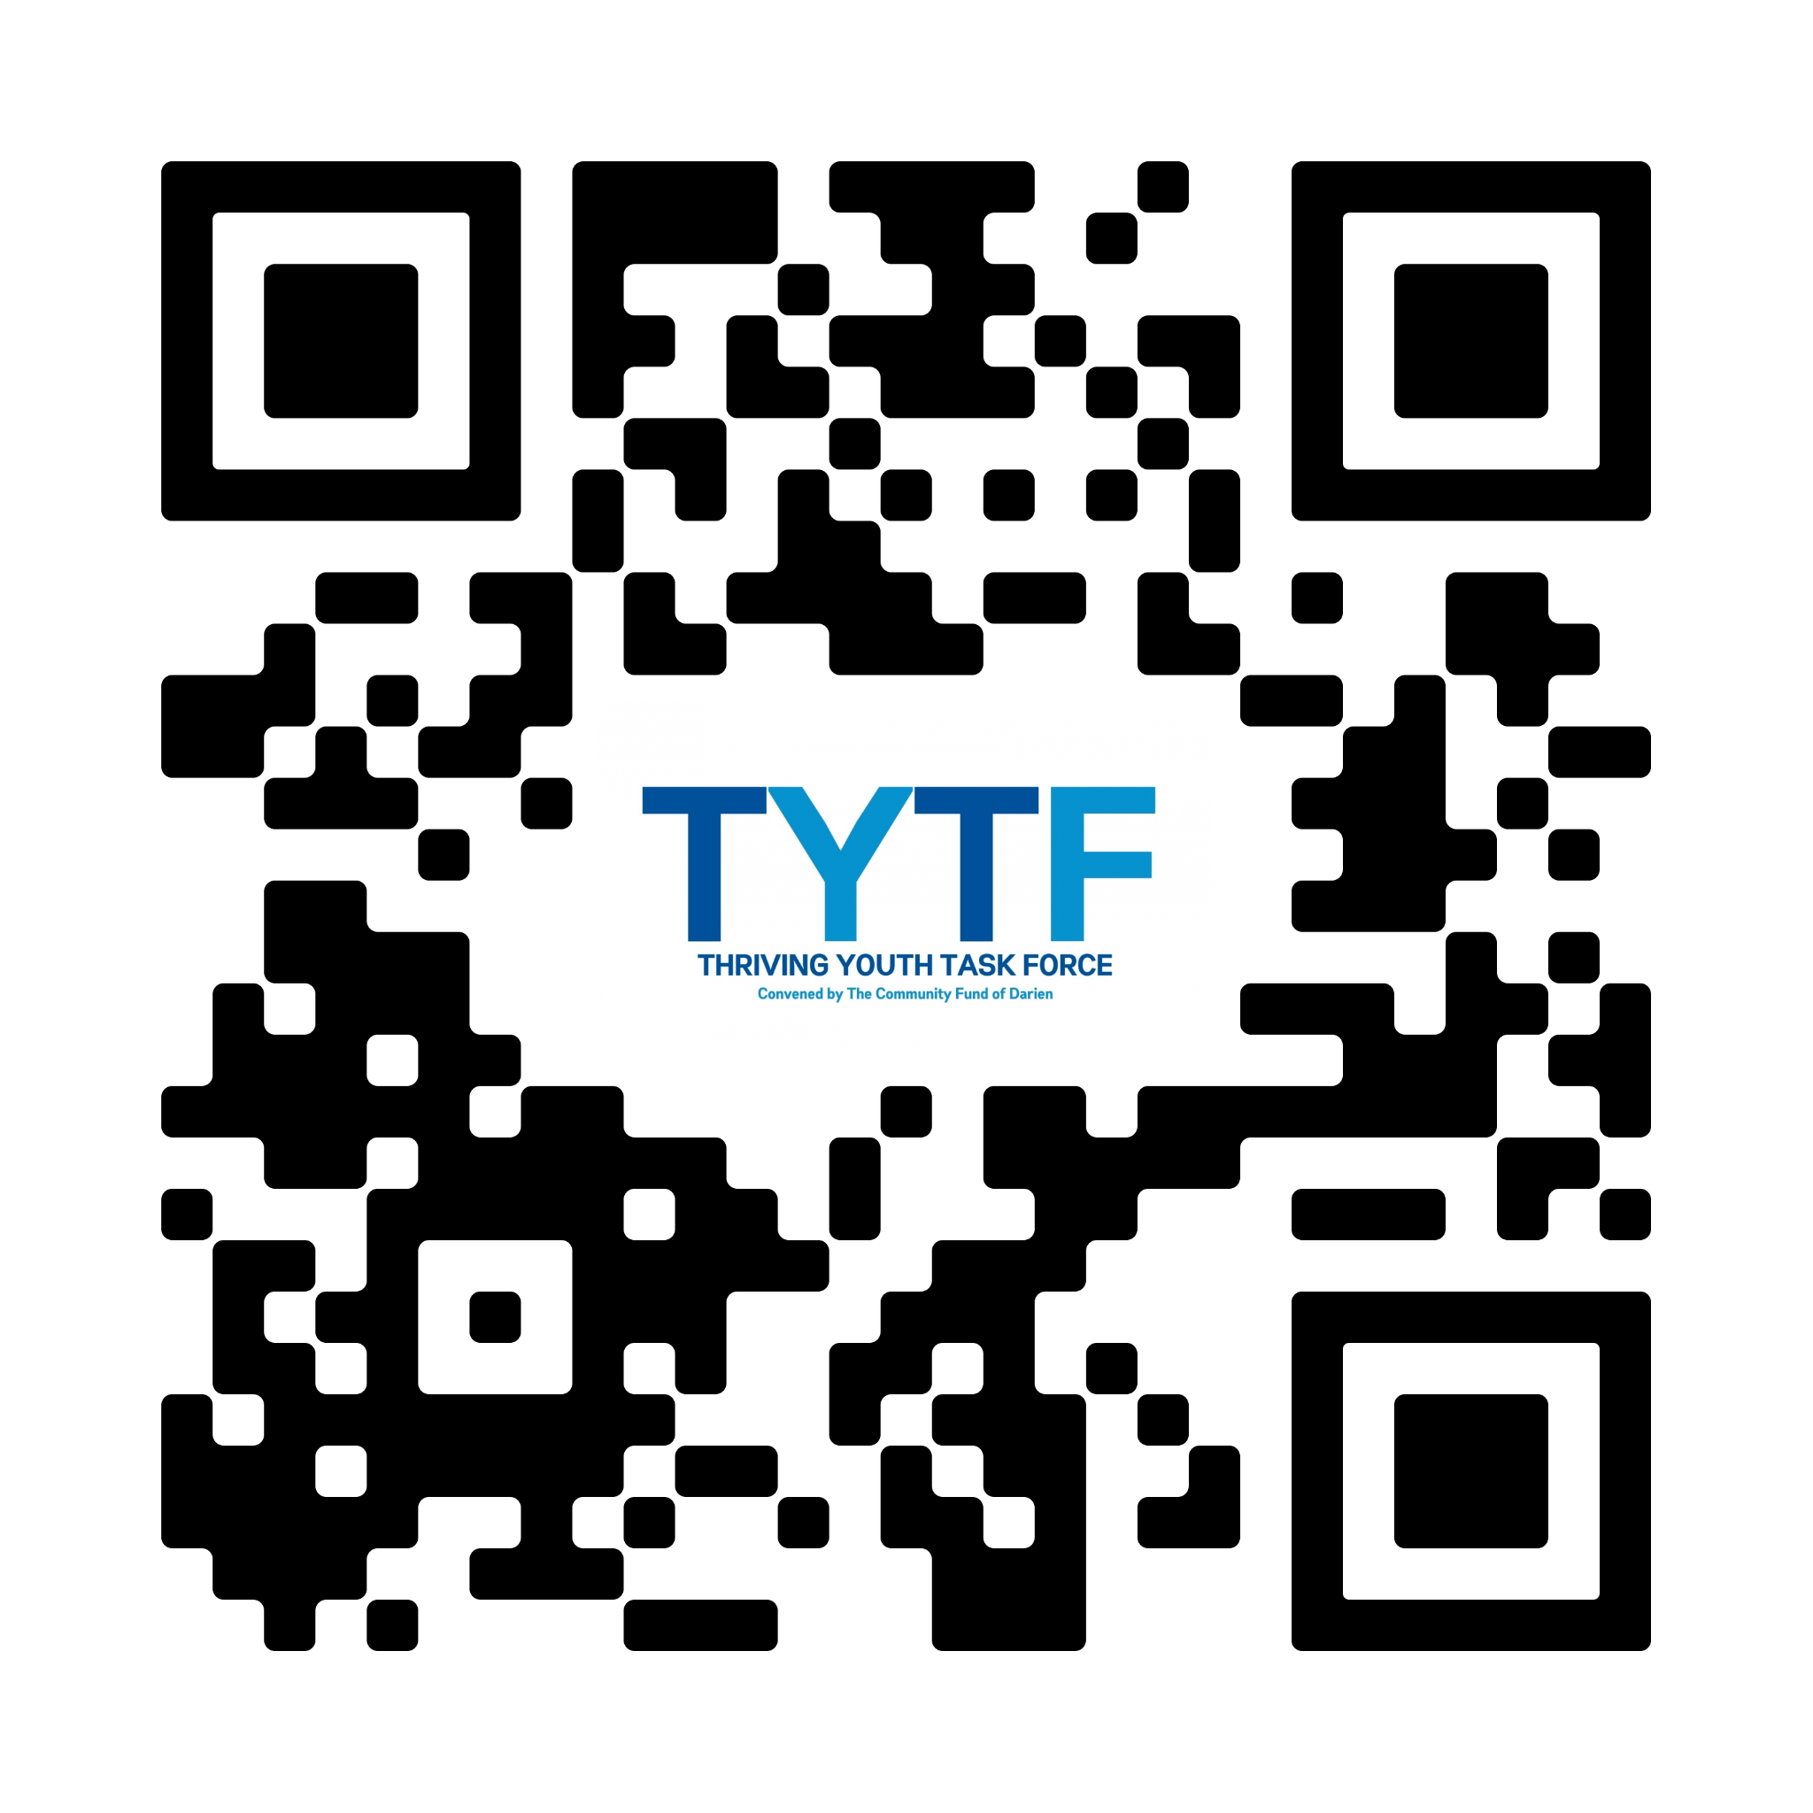
Learn more about our survey findings on our website.
communityfunddarien.org/student-survey-results

Slide 38
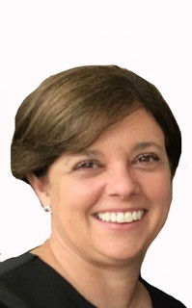
Tracey Masella, LCSW

Slide 39
Rebecca Campbell, LCSW

Slide 40
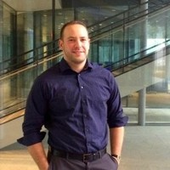
Scott McCarthy, PhD

Slide 41
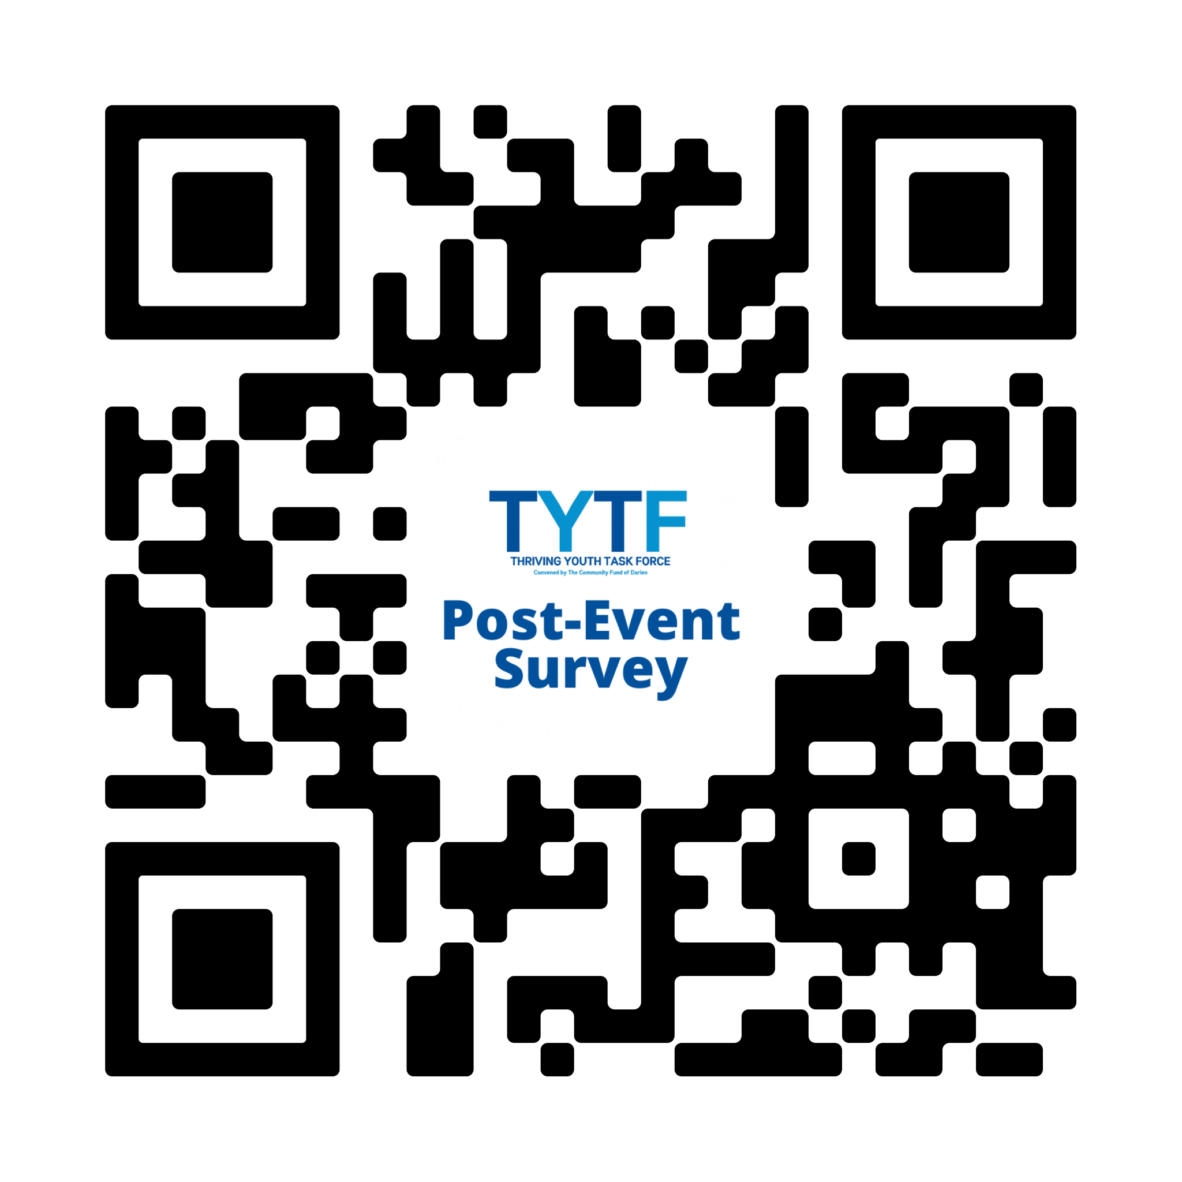
Please provide your feedback and suggestions for future programming.

